Slide 1
The Battle of the Neighborhoods
The Best neighborhood for new Italian restaurant

Slide 2

Problem Background:
The City of New York is the most populous city in the United States. It is diverse and is the financial capital of USA. It is multicultural. It is a dream place for gourmet to seek delicious cuisine. Its food culture includes an array of international cuisines influenced by the city's immigrant history.
As it is highly developed city so cost of doing business is also one of the highest. Thus, the market is highly competitive, any new business venture or expansion needs to be analysed carefully. The insights derived from analysis will give good understanding of the business environment which help in strategically targeting the market.

Slide 3
Problem Description:
New York City attracts many to start their business in the food industry. It's food culture includes an array of international cuisines influenced by the city's immigrant history.
Central and Eastern European immigrants, especially Jewish immigrants introduced bagels, cheesecake, hot dogs to New York. Italian immigrants brought New York-style pizza and Italian cuisine. Jewish immigrants and Irish immigrants is famoused by making pastrami and corned beef. Chinese and other Asian restaurants, sandwich joints, trattorias, diners, and coffeehouses are ubiquitous throughout the city. 4,000 license were issued to mobile food vendors by the city. Middle Eastern foods such as falafel and kebabs examples of modern New York street food. It is famous for not just Pizzerias, Cafe's but also for fine dining Michelin starred restaurants.The city is home to "nearly one thousand of the finest and most diverse haute cuisine restaurants in the world", according to Michelin. it is impractical to run an analysis for each type of restaurant. Based on the maximum total numbers among these restaurants, I choose Pizza Place for the following report. The study of other types of restaurants can be conducted with the same method.

Slide 4
Data Preparation
Data 1 : Neighborhood has a total of 5 boroughs and 306 neighborhoods. In order to segement the neighborhoods and explore them, we will essentially need a dataset that contains the 5 boroughs and the neighborhoods that exist in each borough as well as the the latitude and logitude coordinates of each neighborhood.
This dataset exists for free on the web. Link to the dataset is : https://geo.nyu.edu/catalog/nyu_2451_34572
Data 2 : Second data which will be used is the DOHMH Farmers Markets and Food Boxes dataset. In this we will be using the data of Farmers Markets.
https://data.cityofnewyork.us/dataset/DOHMH-Farmers-Markets-and-Food-Boxes/8vwk-6iz2
Website-https://www.grownyc.org/greenmarketco/foodbox
Data 3 : For the below analysis we will get data from wikipedia as given below :
New York Population New York City Demographics Cuisine of New York city https://en.wikipedia.org/wiki/New_York_City https://en.wikipedia.org/wiki/Economy_of_New_York_City https://en.wikipedia.org/wiki/Portal:New_York_City https://en.wikipedia.org/wiki/Cuisine_of_New_York_City https://en.wikipedia.org/wiki/List_of_Michelin_starred_restaurants_in_New_York_City
Data 4 : New York city geographical coordinates data will be utilized as input for the Foursquare API, that will be leveraged to provision venues information for each neighborhood.We will use the Foursquare API to explore neighborhoods in New York City. The below is image of the Foursquare API data.

Slide 5
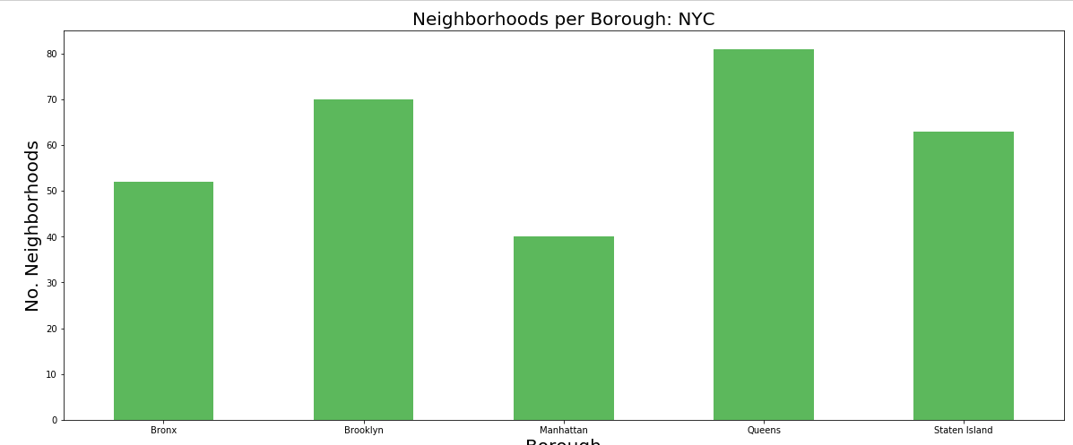
Neighborhoods per Borough in NYC

Slide 6
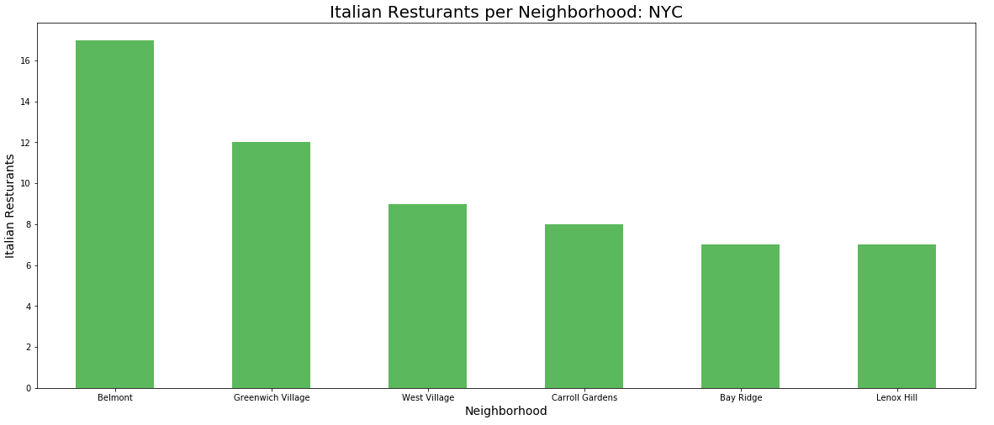
Italian Restaurants per Neighborhood

Slide 7
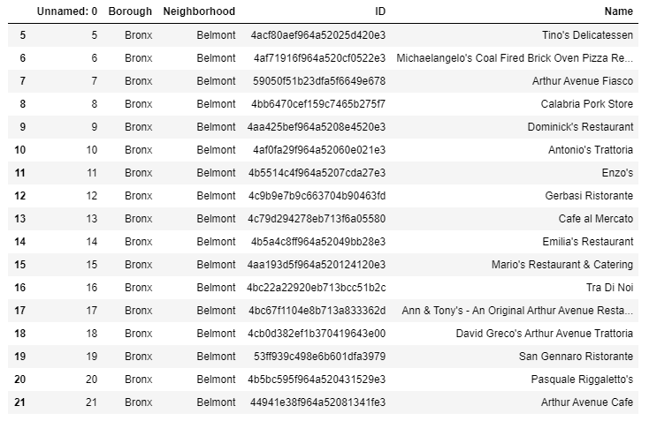
From previous chat we can see Belmont has the most Italian restaurants

Slide 8
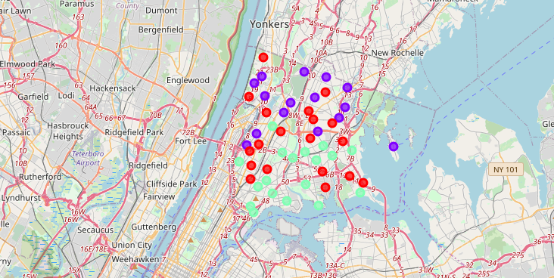
From Folium map

Slide 9
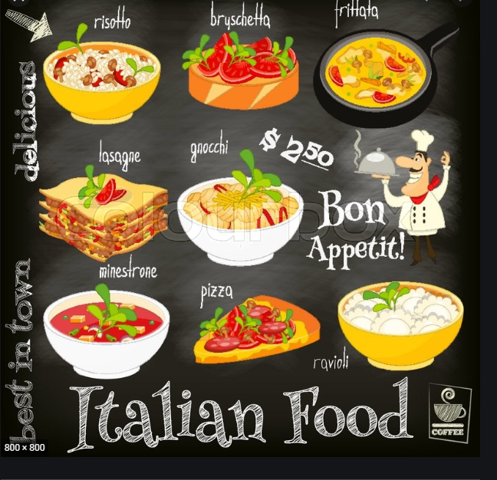
Conclusion
The Bronx has the least number of Italian restaurants per borough. However, of note, Belmont of The Bronx is the neighborhood in all of NYC with the most Italian Restaurants. After studying the Bronx's neighborhoods for Italian restaurants for our client.

